Slide 1
Module 5
Advanced Data Mining Techniques

Slide 2
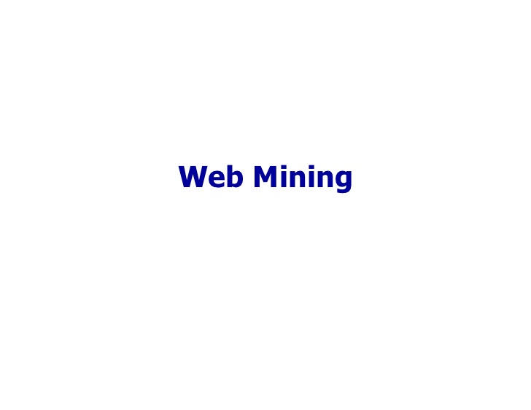

Slide 3
Purpose of Web mining
Finding relevant information: search with a simple query- output is a set of pages based on ranks.
Low precision: due to the irrelevance of many search results (returns pages that are not relevant to our query).
Low recall: due to inability to index all information available on the web. This leads to not returning the most relevant page.
Discovering new knowledge from the web.
Personalised web page synthesis.
Learning about individual users (knowing about users do and want)

Slide 4
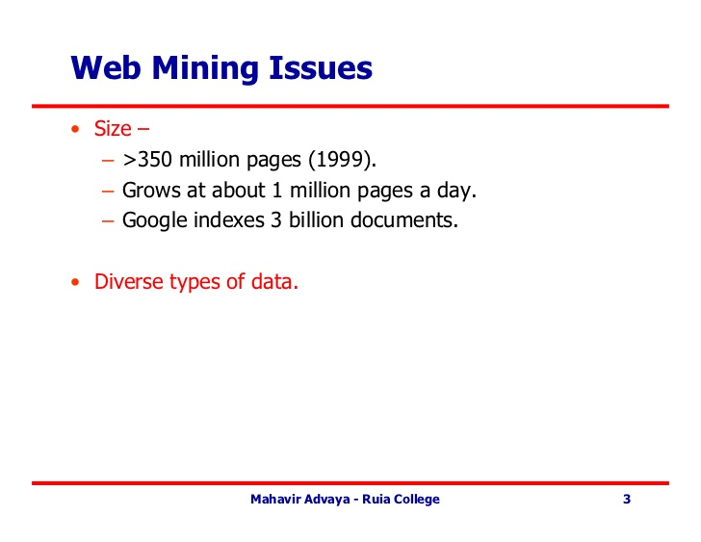

Slide 5
Disadvantages of web pages
One problem associated with retrieval of data from Web documents is that they are not structured as in traditional databases. There is no schema or division into attributes.
Web pages are defined using hypertext markup language (HTML).
Web pages created using HTML are only semistructured, thus querying is more difficult than with well-formed databases containing schemas and attributes with defined domains.

Slide 6
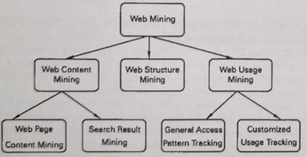
Web Mining Taxonomy
The effectiveness of a set of Web pages depends not only on the content and organization of individual Web pages, but also on the structure of the pages and their ease of use.

Slide 7
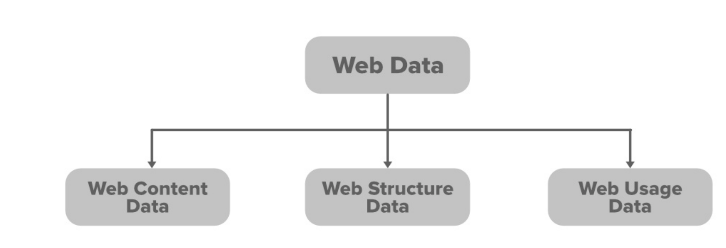

Slide 8
1. Web Content Data: The common forms of web content data are HTML, web pages, images audio-video, etc. The main being the HTML format. Though it may differ from browser to browser the common basic layout/structure would be the same everywhere. Since it’s the most popular in web content data. XML and dynamic server pages like JSP, PHP, etc. are also various forms of web content data.
2. Web Structure Data: On a web page, there is content arranged according to HTML tags (which are known as intrapage structure information). The web pages usually have hyperlinks that connect the main webpage to the sub-web pages. This is called Inter-page structure information. So basically relationship/links describing the connection between webpages is web structure data.
3. Web Usage Data: The main source of data here is-Web Server and Application Server. It involves log data which is collected by the main above two mentioned sources. Log files are created when a user/customer interacts with a web page. The data in this type can be mainly categorized into three types based on the source it comes from:
Server-side
Client-side
Proxy side.
There are other additional data sources also which include cookies, demographics, etc.

Slide 9
Web Content Mining: Web content mining is the application of extracting useful information from the content of the web documents. Web content consist of several types of data – text, image, audio, video etc. Content data is the group of facts that a web page is designed. It can provide effective and interesting patterns about user needs.
Web Structure Mining: Web structure mining is the application of discovering structure information from the web. The structure of the web graph consists of web pages as nodes, and hyperlinks as edges connecting related pages. Structure mining basically shows the structured summary of a particular website. It identifies relationship between web pages linked by information or direct link connection.
Web Usage Mining: Web usage mining is the application of identifying or discovering interesting usage patterns from large data sets. And these patterns enable you to understand the user behaviors or something like that. In web usage mining, user access data on the web and collect data in form of logs. So, Web usage mining is also called log mining.

Slide 10
Web Content Mining

Slide 11
Textual, image, audio, video, hyperlinks, metadata – multimedia data mining.
It is the application of web mining that extracts relevant or useful information content from the Web.
Web Content mining is different from data mining and text mining. Due to heterogeneity and the absence of web data, automated discovery of new knowledge patterns can be challenging to some extent.
Web data are generally semi-structured and/or unstructured, while data mining is primarily concerned with structured data.
It performs scanning and mining of text, images, and groups of web pages according to the content of input by displaying the list in search engines.

Slide 12
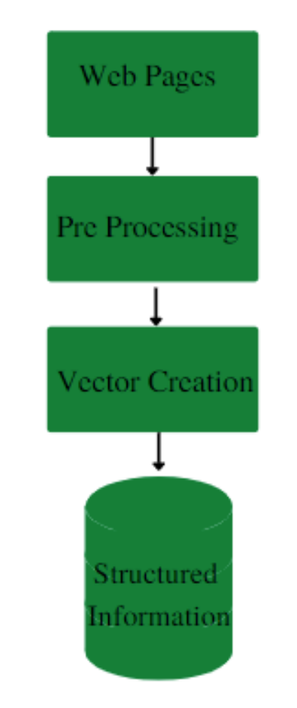
Unstructured Web Data Mining
Unstructured data includes data such as audio, video, etc, We convert these unstructured data into structured data,i.e., into useful information or structured information (which is known as Web Content Mining). The process of Conversion is mentioned as follows:

Slide 13
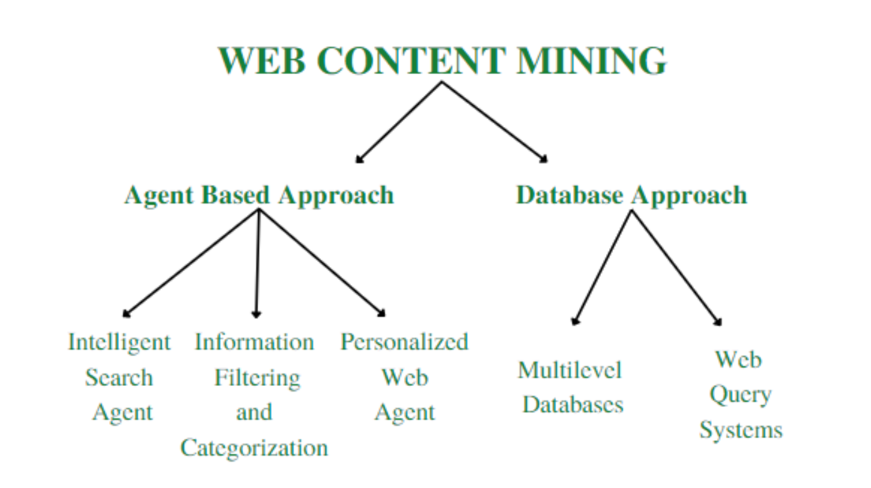

Slide 14
Web Content Mining Techniques:
Pre-processing
Clustering
Classifying
Identifying the associations
Topic identification, tracking
Applications of Web Content Mining:
Classifying the web documents into categories.
Identify topics of web documents.
Finding similar web pages across the different web servers.
Applications related to relevance.

Slide 15
1. Pre-processing
Before applying any mining techniques, web content needs to be cleaned and transformed. Pre-processing involves:
Removing Stopwords: Common words like “the,” “is,” “and” are removed to improve efficiency.
Tokenization: Splitting text into meaningful words or phrases.
Stemming & Lemmatization: Reducing words to their base form (e.g., running → run).
Normalization: Converting text to a standard format, such as lowercasing all words.
🔹 Example: Suppose we extract a blog article on “Artificial Intelligence.” Before analysis, we remove unnecessary words, punctuation, and convert everything to lowercase to enhance processing efficiency.

Slide 16
2. Clustering
Clustering groups similar web content together based on features. It is used for automatic categorization.
K-Means Clustering: Groups data into k clusters based on similarity.
Hierarchical Clustering: Builds a tree of clusters based on similarity measures.
🔹 Example: A news website clusters articles into categories like Sports, Technology, Business, and Health based on keywords and content similarity.

Slide 17
3. Classifying
Classification assigns predefined labels to web content based on patterns and machine learning models.
Naïve Bayes Classifier: Commonly used for text classification.
Support Vector Machines (SVM): Works well for document classification.
🔹 Example: A spam filter classifies emails as spam or not spam based on words present in the email content.

Slide 18
4. Identifying the Associations
Association rule mining finds relationships between words or concepts appearing together frequently.
Apriori Algorithm: Identifies common word patterns and relationships.
FP-Growth Algorithm: A faster way to mine frequent itemsets without candidate generation.
🔹 Example: An e-commerce website might discover that users searching for “smartphones” often also look for “phone cases”, leading to better recommendations.

Slide 19
5. Topic Identification & Tracking
This technique finds the main topics in large collections of web documents and tracks their evolution over time.
Natural Language Processing (NLP): Extracts key topics from web articles.
🔹 Example: A news aggregator website tracks trending topics like “COVID-19 updates” or “AI advancements” by analyzing news articles over time.

Slide 20
Web Structure Mining

Slide 21
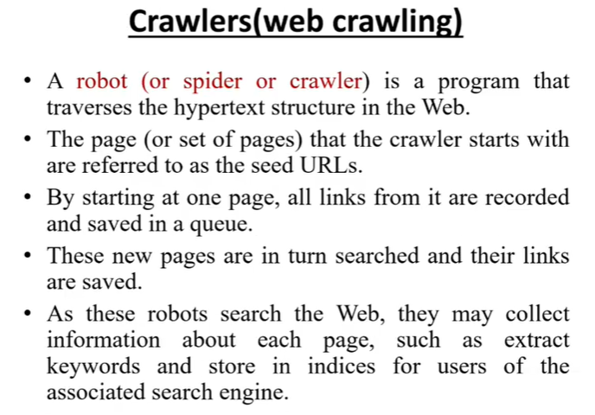

Slide 22
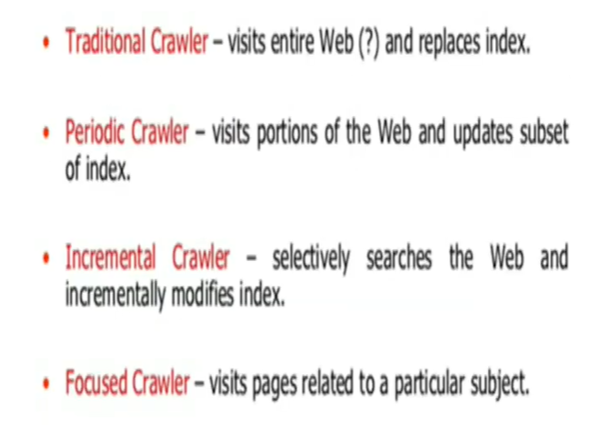

Slide 23
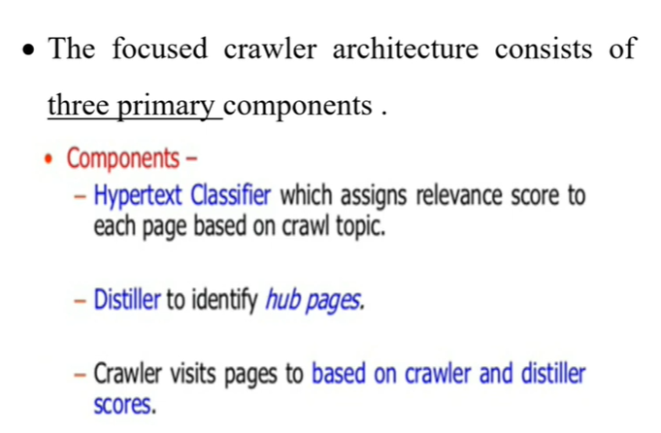

Slide 24
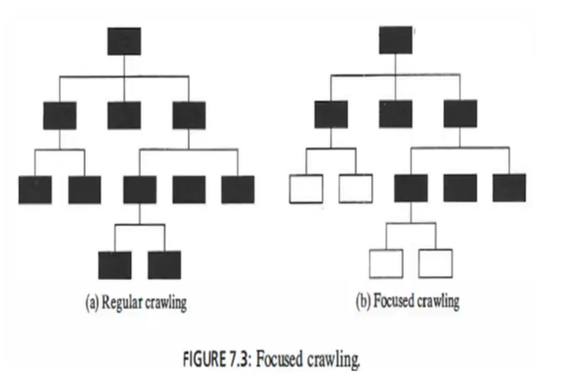

Slide 25
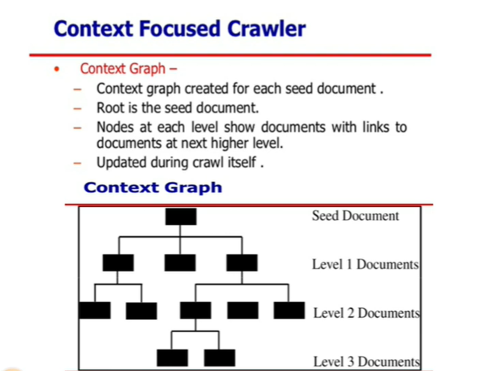
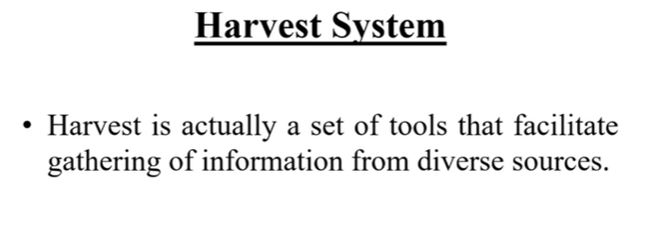

Slide 26
Web Structure Mining
Depending upon the type of Web Structural data, Web Structure Mining can be categorised into two types:
1.Extracting patterns from the hyperlink in the Web: The Web works through a system of hyperlinks using the hyper text transfer protocol (http). Hyperlink is a structural component that connects the web page according to different location. Any page can create a hyperlink of any other page and that page can also be linked to some other page. the intertwined or self-referral nature of web lends itself to some unique network analytical algorithms. The structure of Web pages could also be analyzed to examine the pattern of hyperlinks among pages.
2. Mining the document structure. It is the analysis of tree like structure of web page to describe HTML or XML usage or the tags usage . There are different terms associated with Web Structure Mining :
Web Graph: Web Graph is the directed graph representing Web.
Node: Node represents the web page in the graph.
Edge(s): Edge represents the hyperlinks of the web page in the graph (Web graph)
In degree(s): It is the number of hyperlinks pointing to a particular node in the graph.
Degree(s): Degree is the number of links generated from a particular node. These are also called the Out Degrees.

Slide 27
Web Structure Mining
Discovering the model underlying the link structures of the web.
Used to study the topology of hyperlinks with or without descriptions of the links.
Used for categorizing web pages, similarities and the relationships between different websites.
Authorised site identification.
Web content mining: intra-document mining.
Web structure mining: inter-document structuring.
Web Structure Mining is the technique of discovering structure information from the web. It uses graph theory to analyze the nodes and connections in the structure of a website.

Slide 28
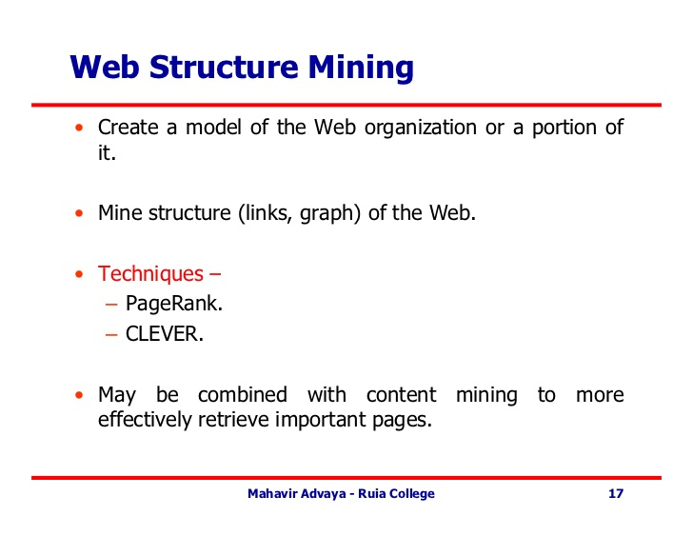

Slide 29
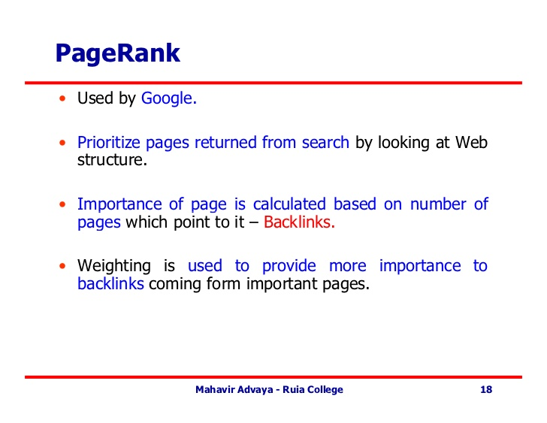

Slide 30
Page Rank Algorithm and Implementation
PageRank (PR) is an algorithm used by Google Search to rank websites in their search engine results. PageRank was named after Larry Page, one of the founders of Google. PageRank is a way of measuring the importance of website pages.
PageRank works by counting the number and quality of links to a page to determine a rough estimate of how important the website is. The underlying assumption is that more important websites are likely to receive more links from other websites.

Slide 31
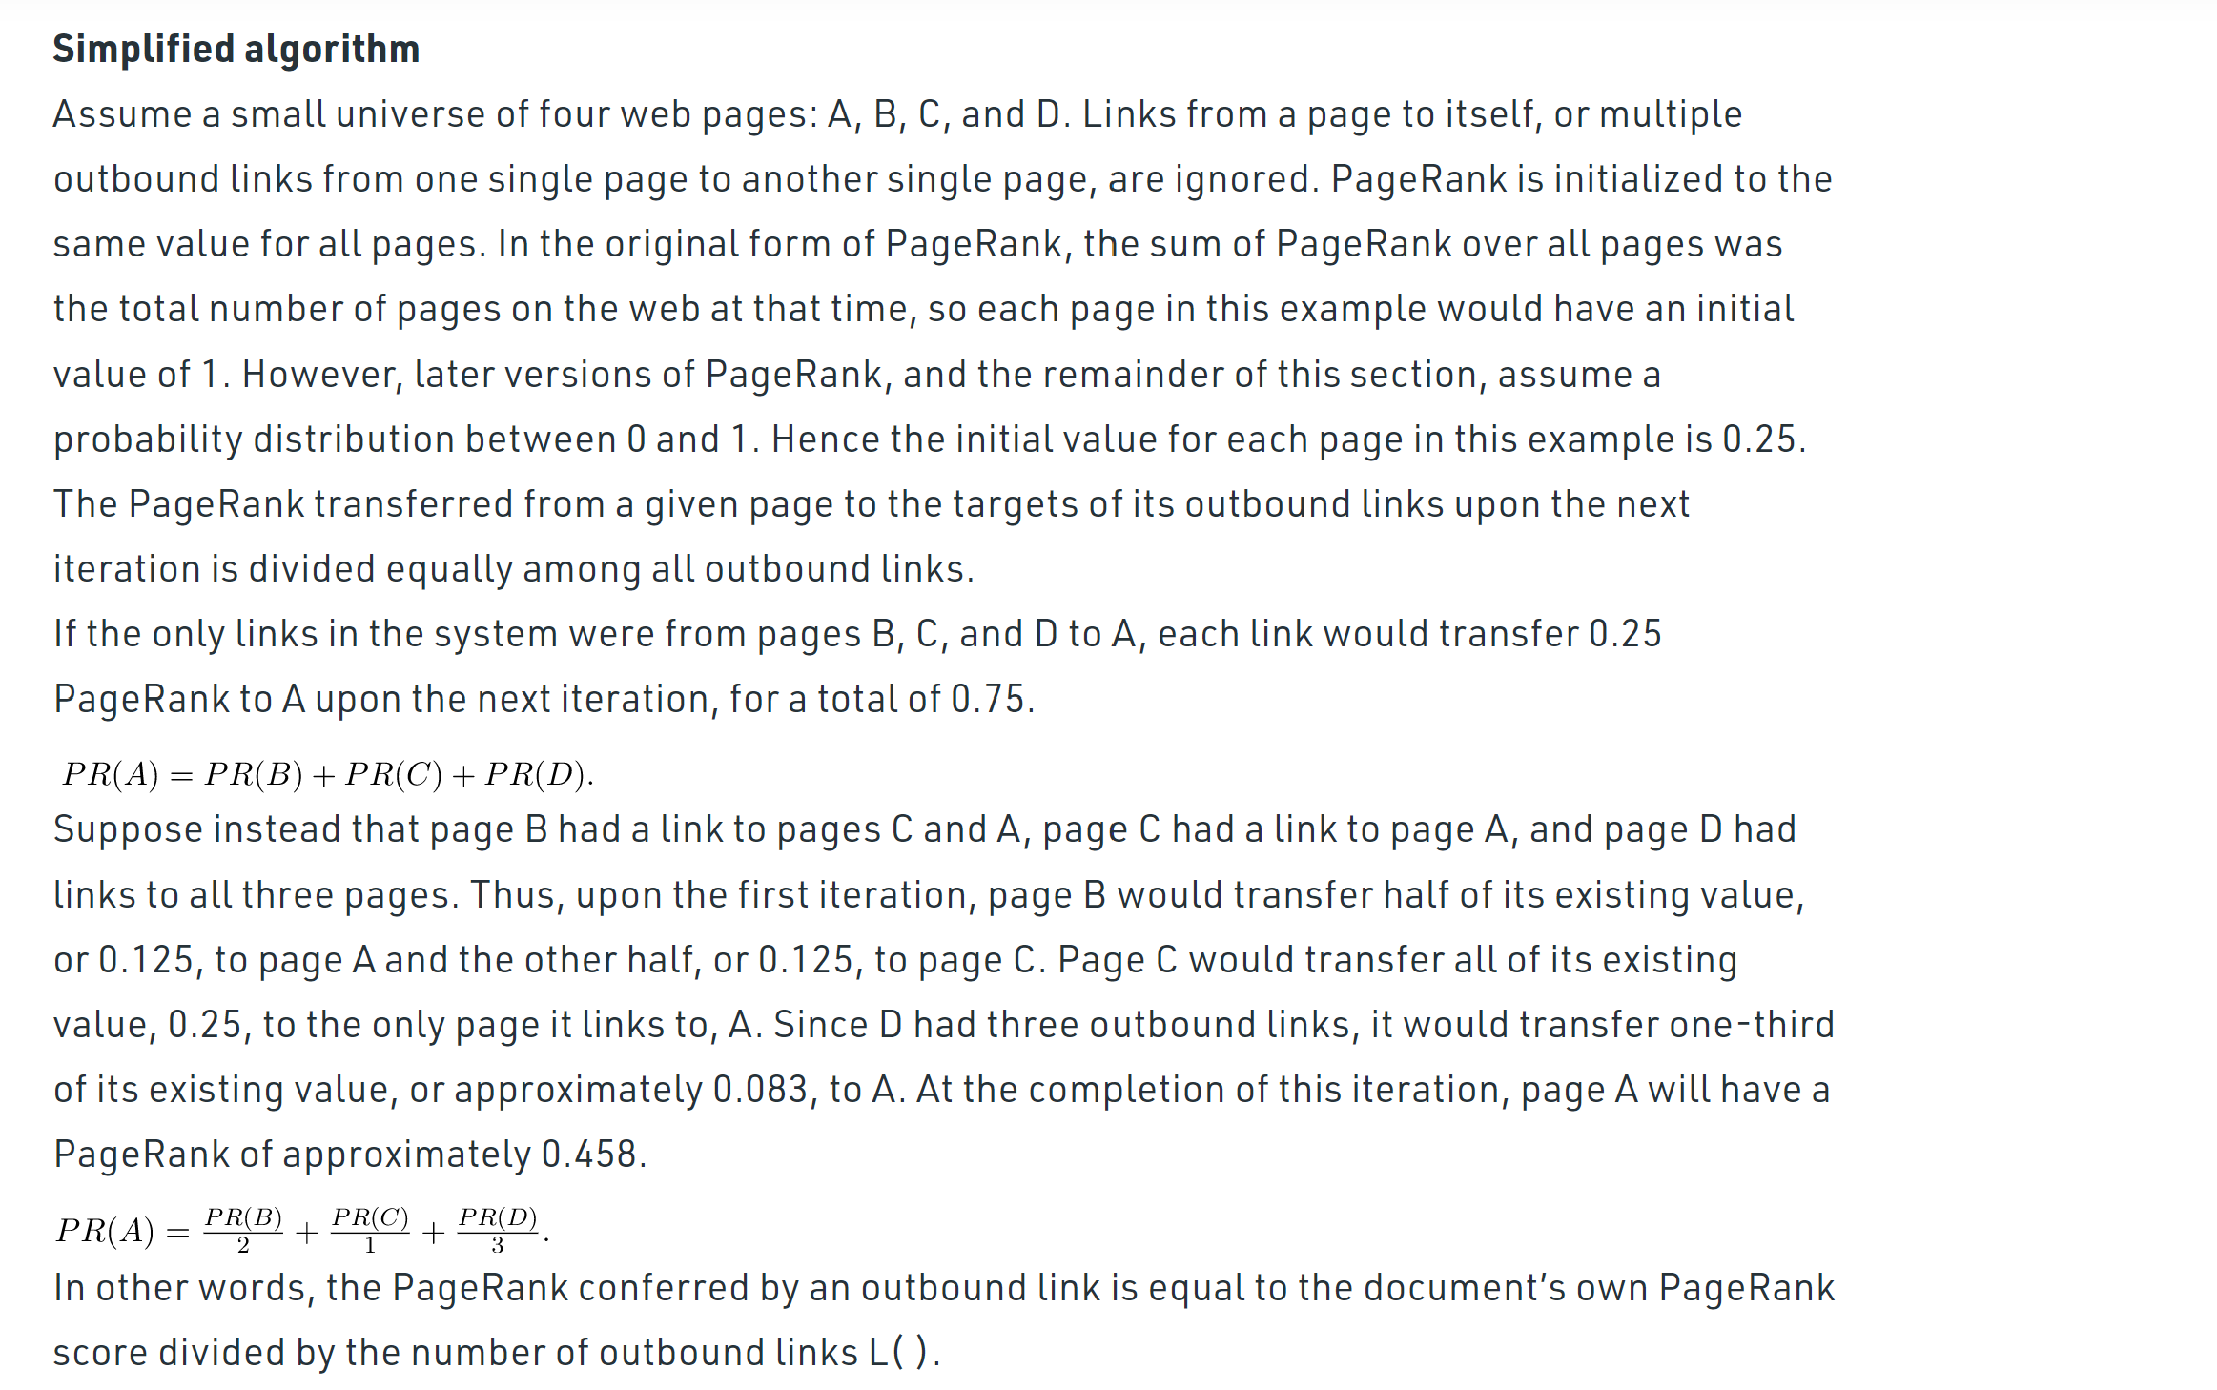

Slide 32
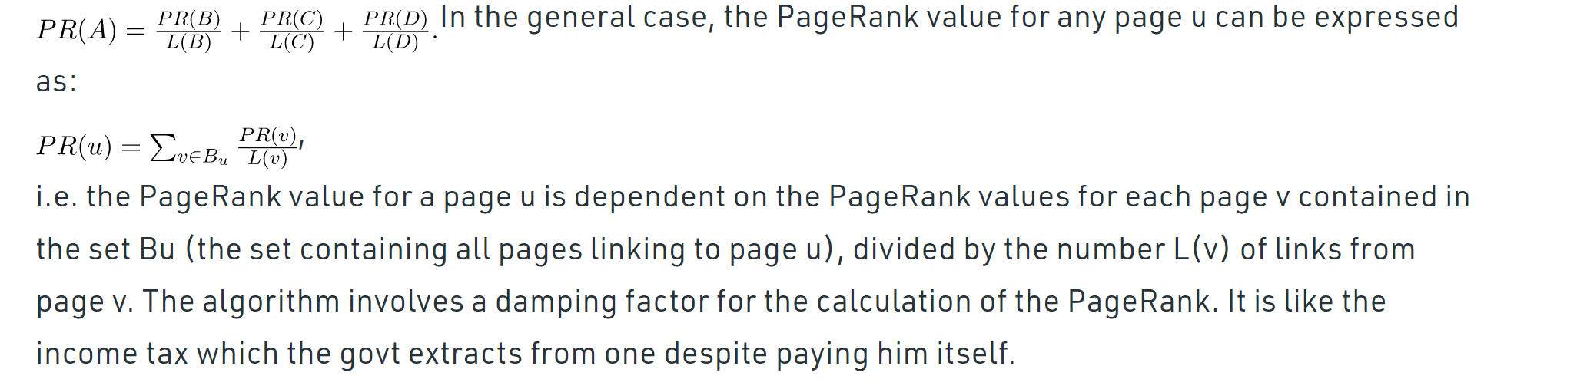

Slide 33
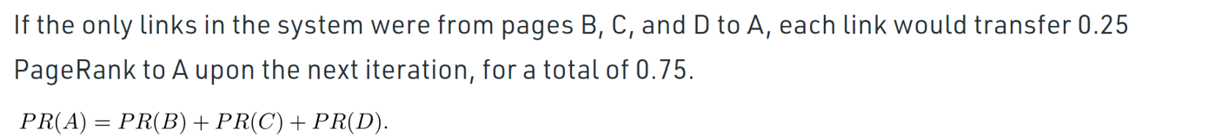
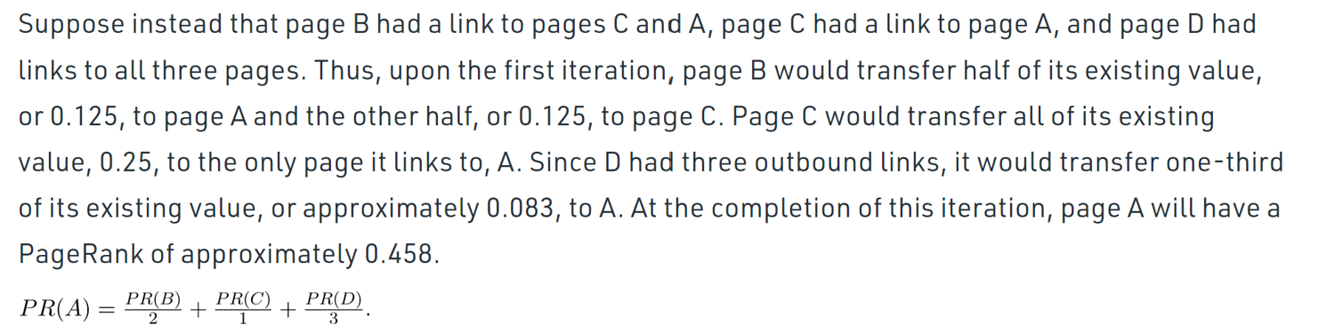
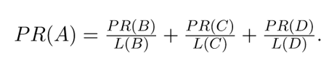
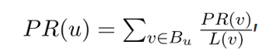

Slide 34
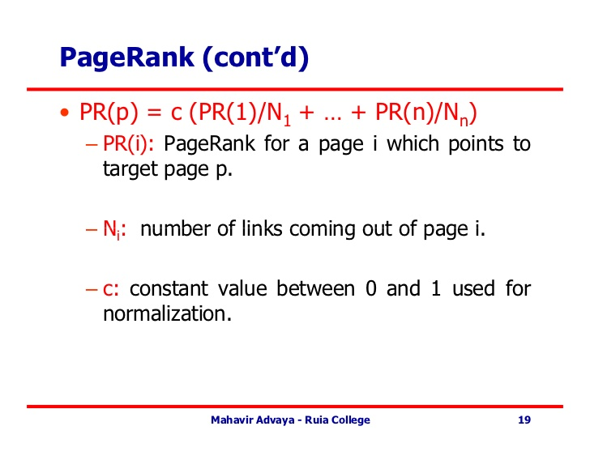

Slide 35
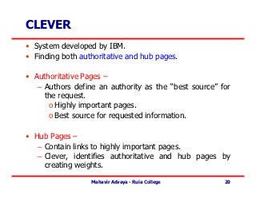
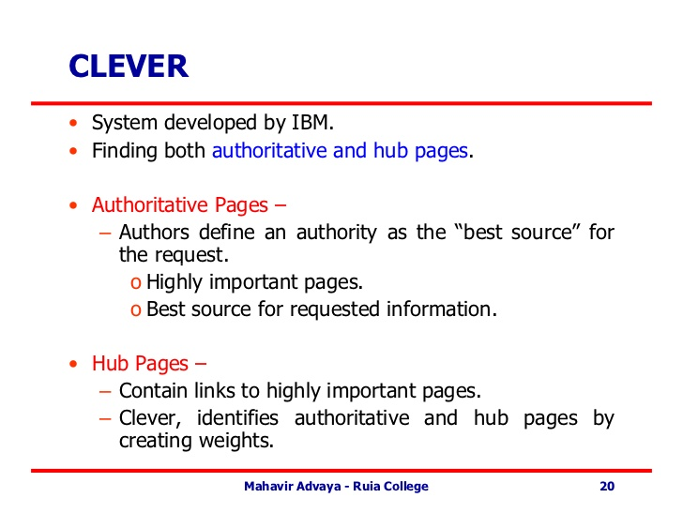

Slide 36
Clever
Clever, is aimed at finding both authoritative pages and hubs.
The authors define an authority as the "best source" for the requested information.
In addition, a hub is a page that contains links to authoritative pages.
The Clever system identifies authoritative pages and hub pages by creating weights.
A search can be viewed as having a goal of finding the best hubs and authorities.
Because of the distributed and unsupervised development of sites, a user has no way of knowing whether the information contained within a Web page is accurate.
Currently, there is nothing to prevent someone from producing a page that contains not only errors, but also blatant lies.
In addition, some pages might be of a higher quality than others.
These pages are often referred to as being the most authoritative. Note that this is different from relevant.
A page may be extremely relevant, but if it contains factual errors, users certainly do not want to retrieve it.

Slide 37
Applications of Web Structure Mining:
Information retrieval in social networks.
To find out the relevance of each web page.
Measuring the completeness of Websites.
Used in Search engines to find the relevant information.

Slide 38
Web Usage Mining

Slide 39
Web usage Mining
Studying the data generated by the web surfers’ sessions or behaviours.
Mines the secondary data derived from the interaction of the users with the web.
Secondary information: access logs, proxy server logs, browser logs, user profiles, registration data, user sessions or transactions, cookies, book mark, user queries etc. Web usage mining performs mining on Web usage data, or Web logs.
A Web log is a listing of page reference data. Sometimes it is referred to as clickstream data because each entry corresponds to a mouse click.
These logs can be examined from either a client perspective or a server perspective.

Slide 40
2 approaches:
General Access pattern tracking:
User navigation pattern.
General access pattern tracking analyses the web logs to understand access patterns and trends.
Customised Usage Tracking
Learn a user profile or user modeling in adaptive interfaces.
Customised usage tracking analyses individual trends.
Enables customized websites for users.(dynamically)

Slide 41
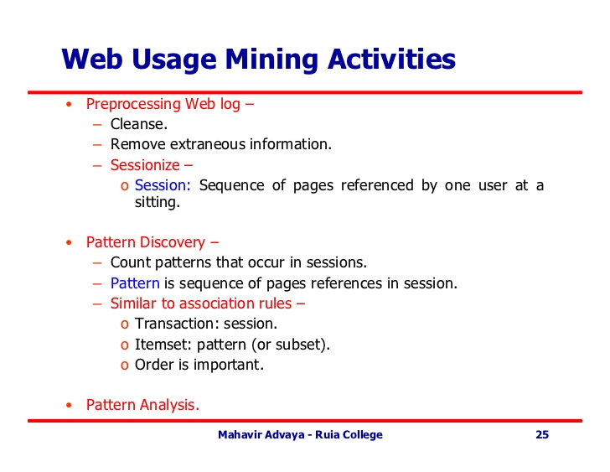

Slide 42
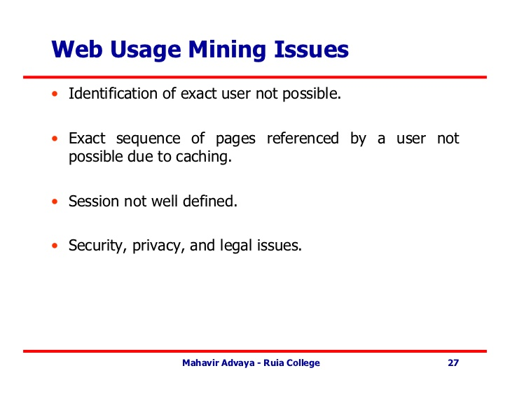

Slide 43
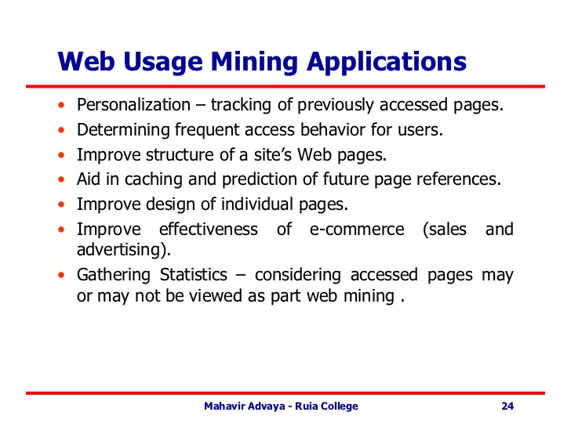

Slide 44
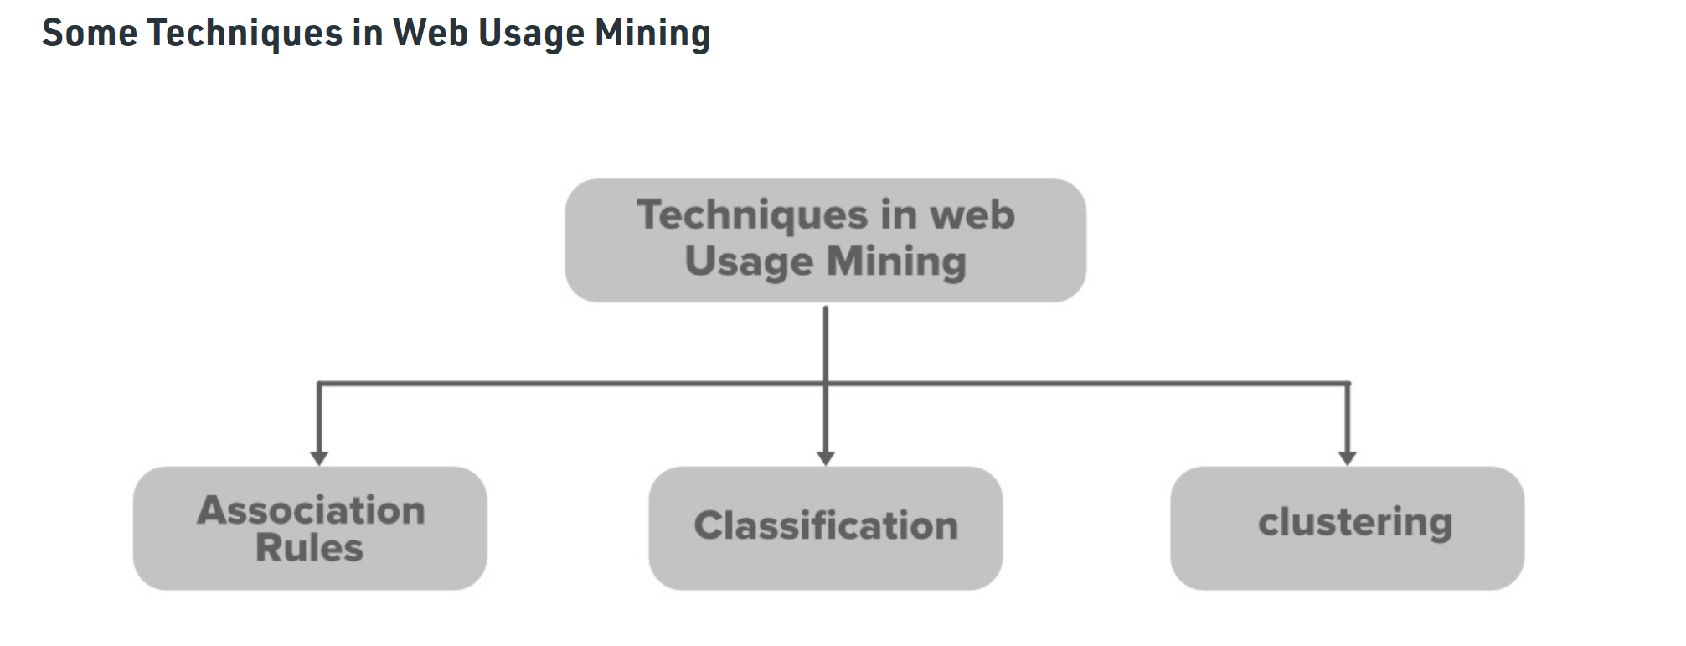
Advantages of Web Usage Mining
Government agencies are benefited from this technology to overcome terrorism.
Predictive capabilities of mining tools have helped identify various criminal activities.
Customer Relationship is being better understood by the company with the aid of these mining tools. It helps them to satisfy the needs of the customer faster and efficiently.
Disadvantages of Web Usage Mining
Privacy stands out as a major issue. Analyzing data for the benefit of customers is good. But using the same data for something else can be dangerous. Using it within the individual’s knowledge can pose a big threat to the company.
Having no high ethical standards in a data mining company, two or more attributes can be combined to get some personal information of the user which again is not respectable.

Slide 45
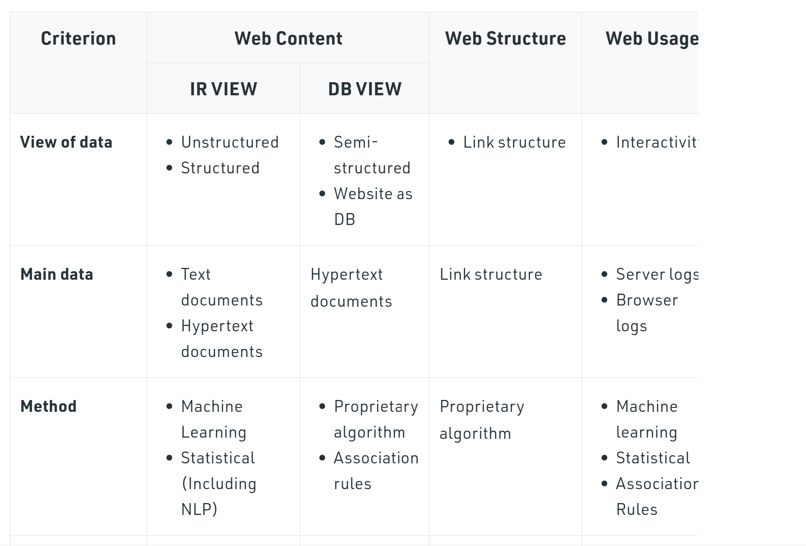
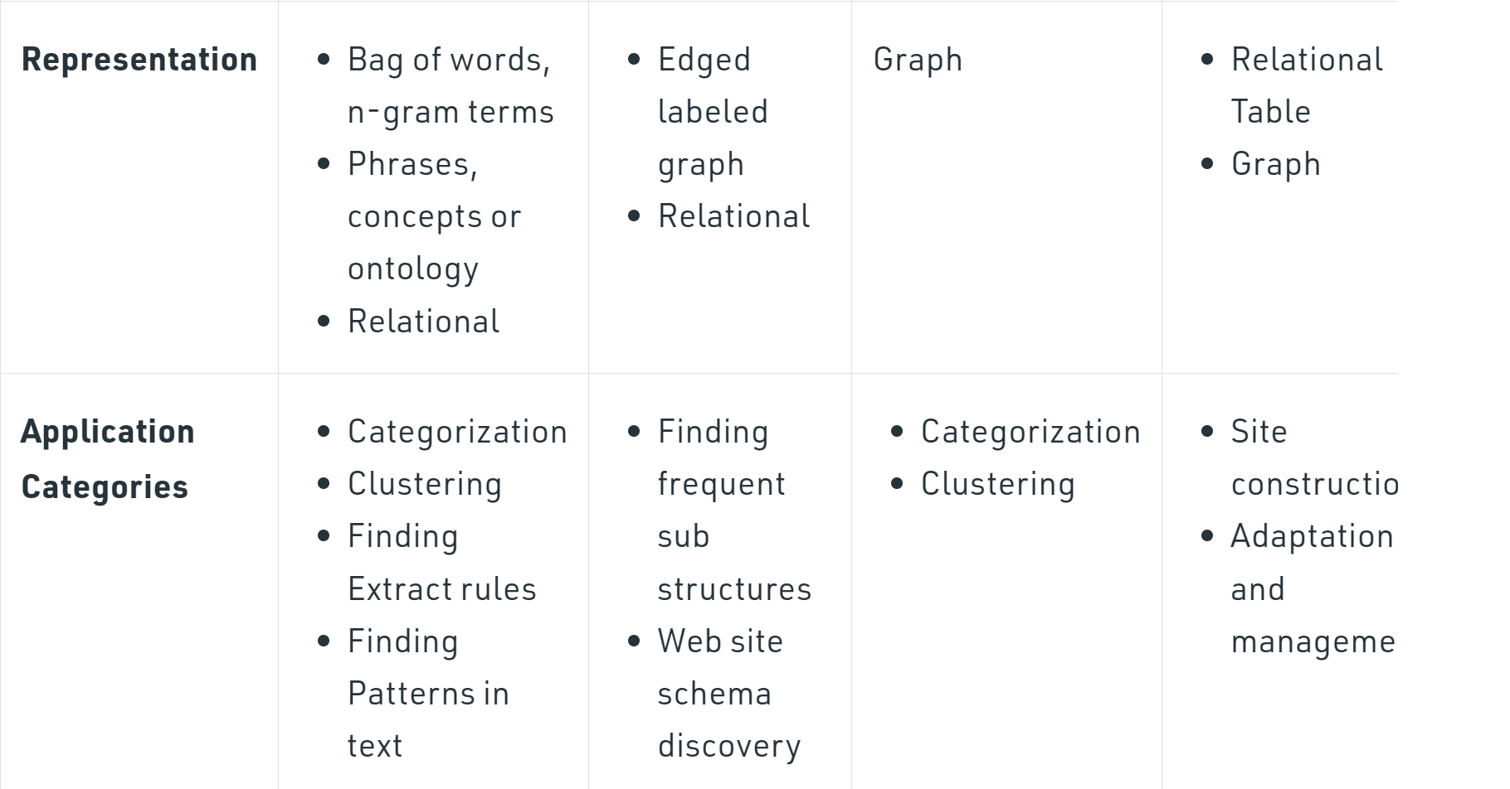
Difference Between Web Content, Web Structure, and Web Usage Mining :

Slide 46
HITS Algorithm
Hyperlink Induced Topic Search (HITS) is an algorithm used in link analysis. It could discover and rank the webpages relevant for a particular search. The idea of this algorithm originated from the fact that an ideal website should link to other relevant sites and also being linked by other important site

Slide 47
Given a query to a Search Engine, the set of highly relevant web pages are called Roots. They are potential Authorities.
Pages that are not very relevant but point to pages in the Root are called Hubs. Thus, an Authority is a page that many hubs link to whereas a Hub is a page that links to many authorities.

Slide 48
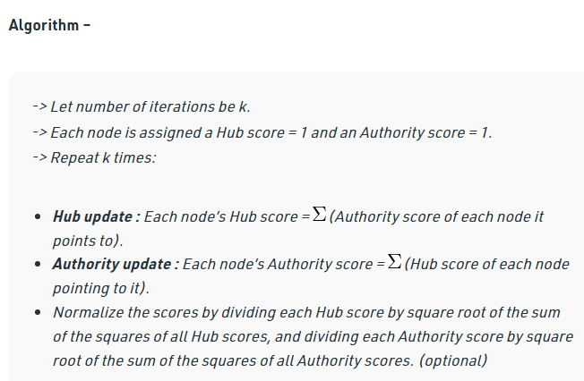

Slide 49
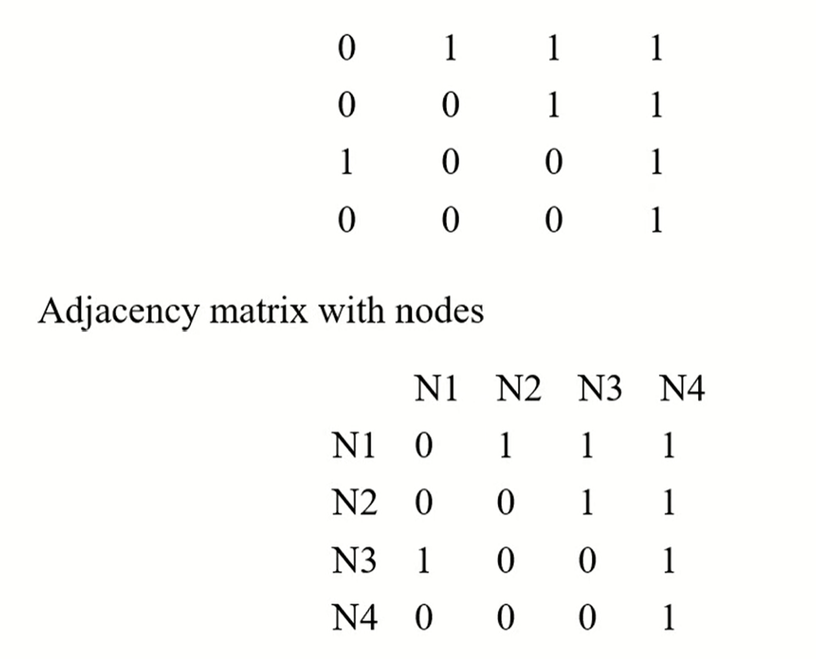
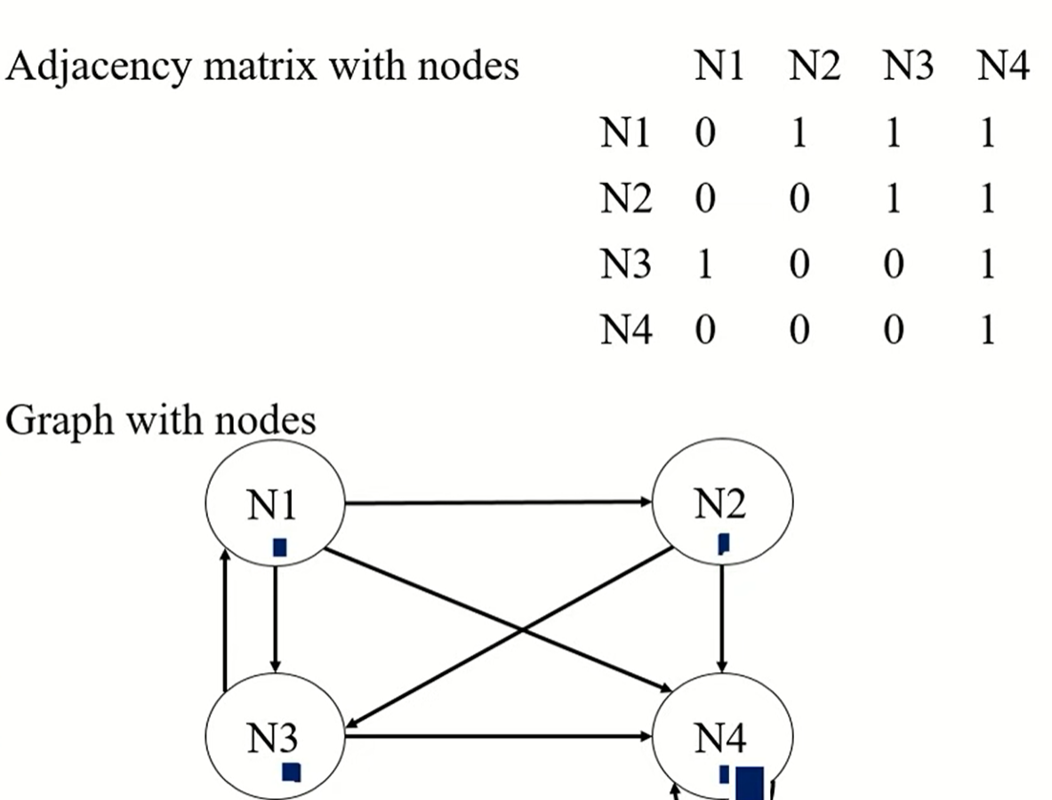

Slide 50
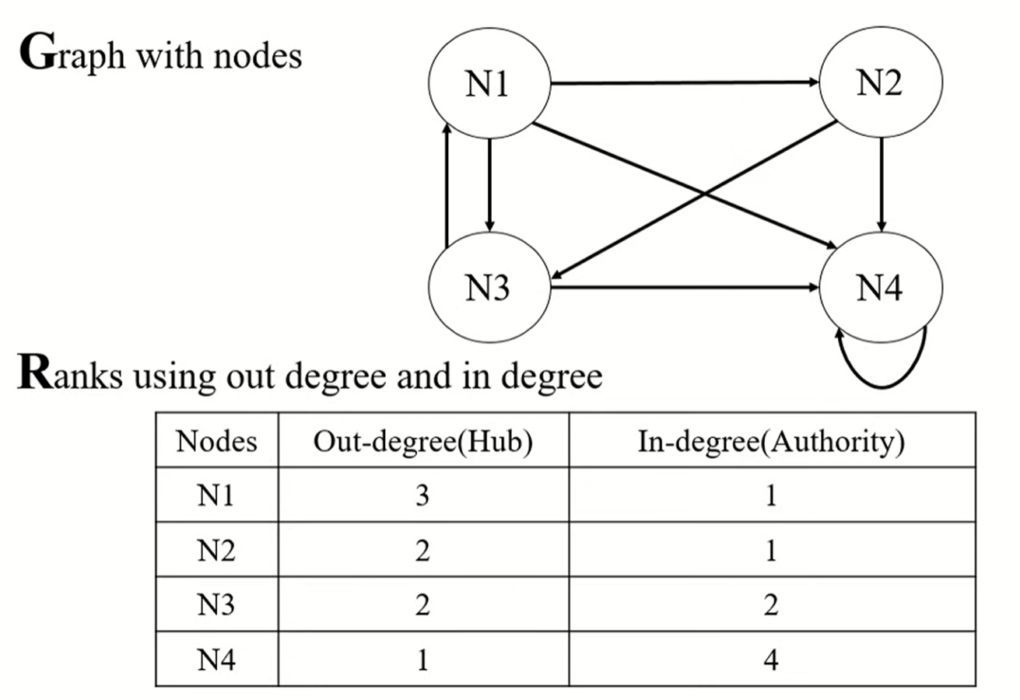
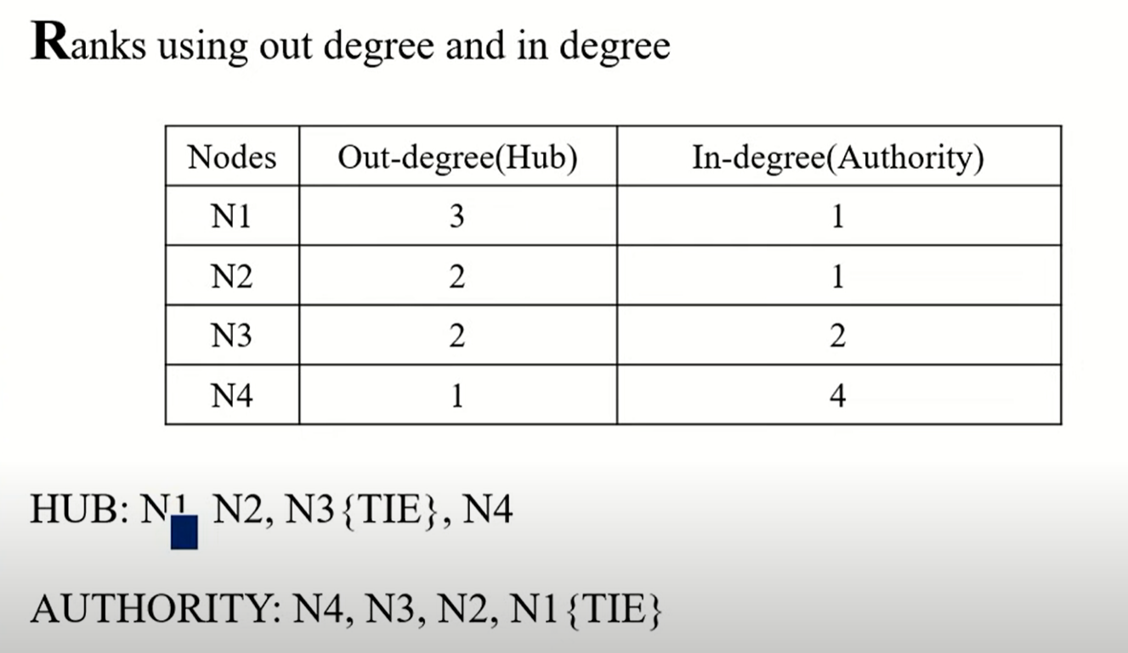

Slide 51
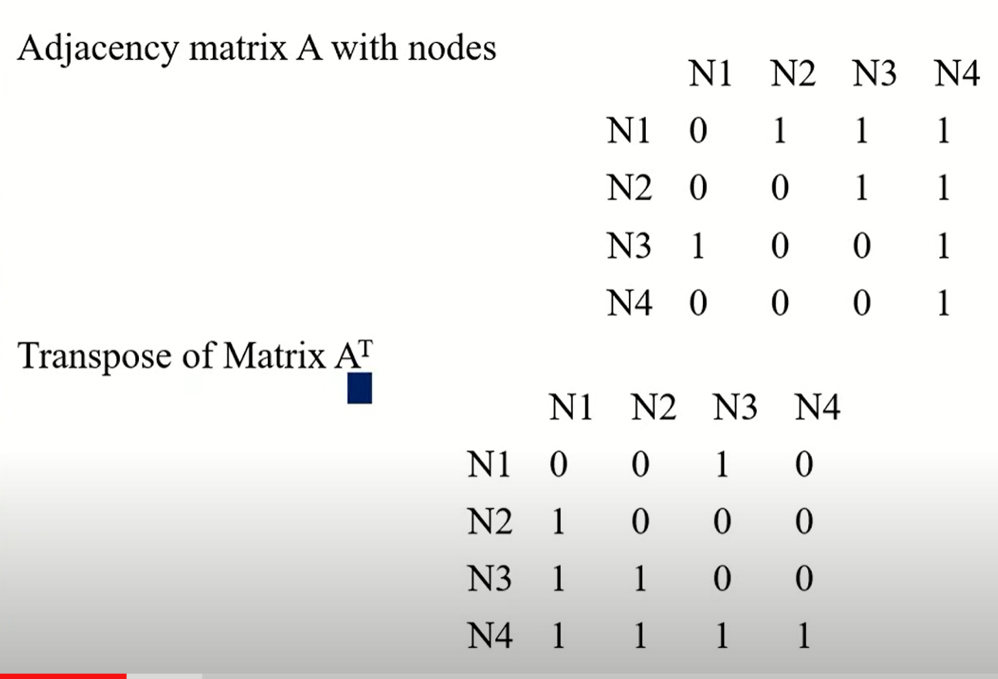
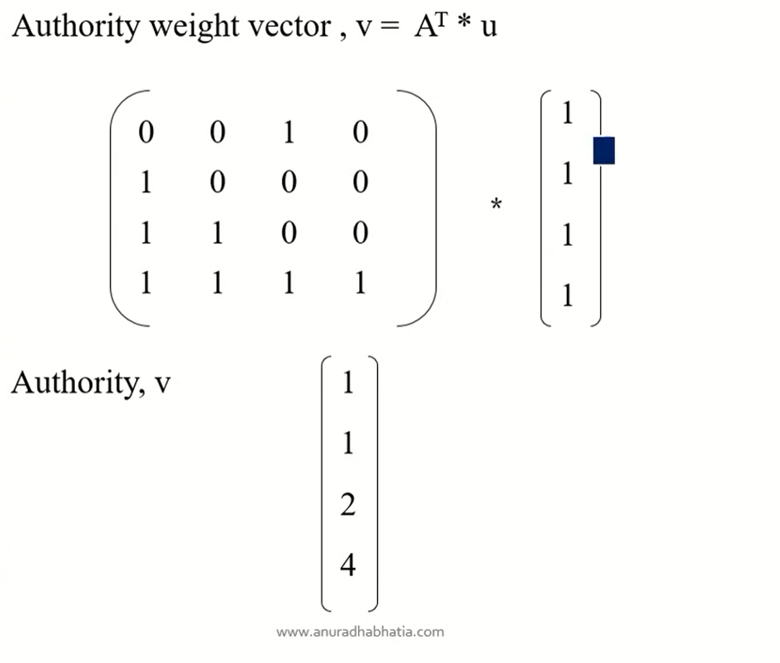
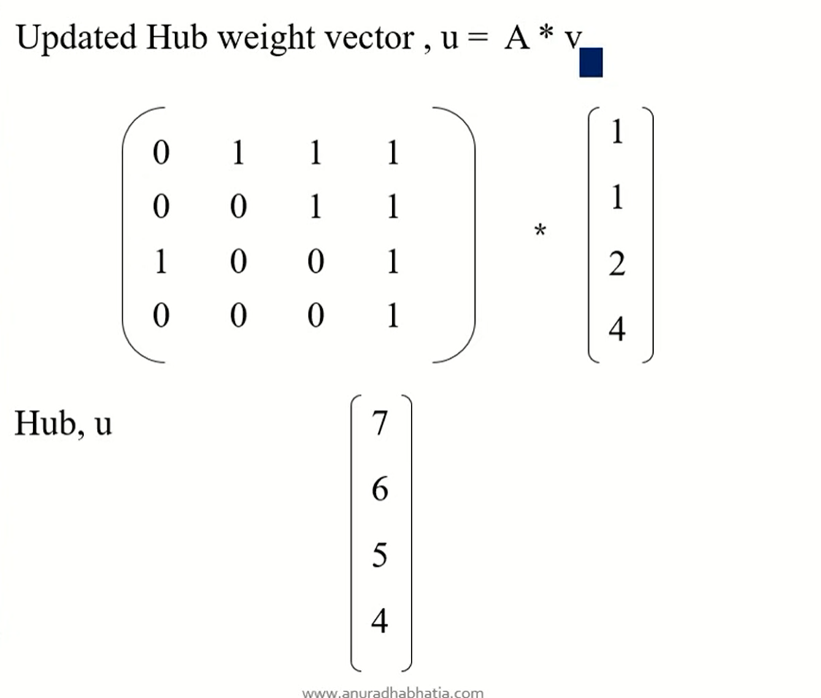

Slide 52
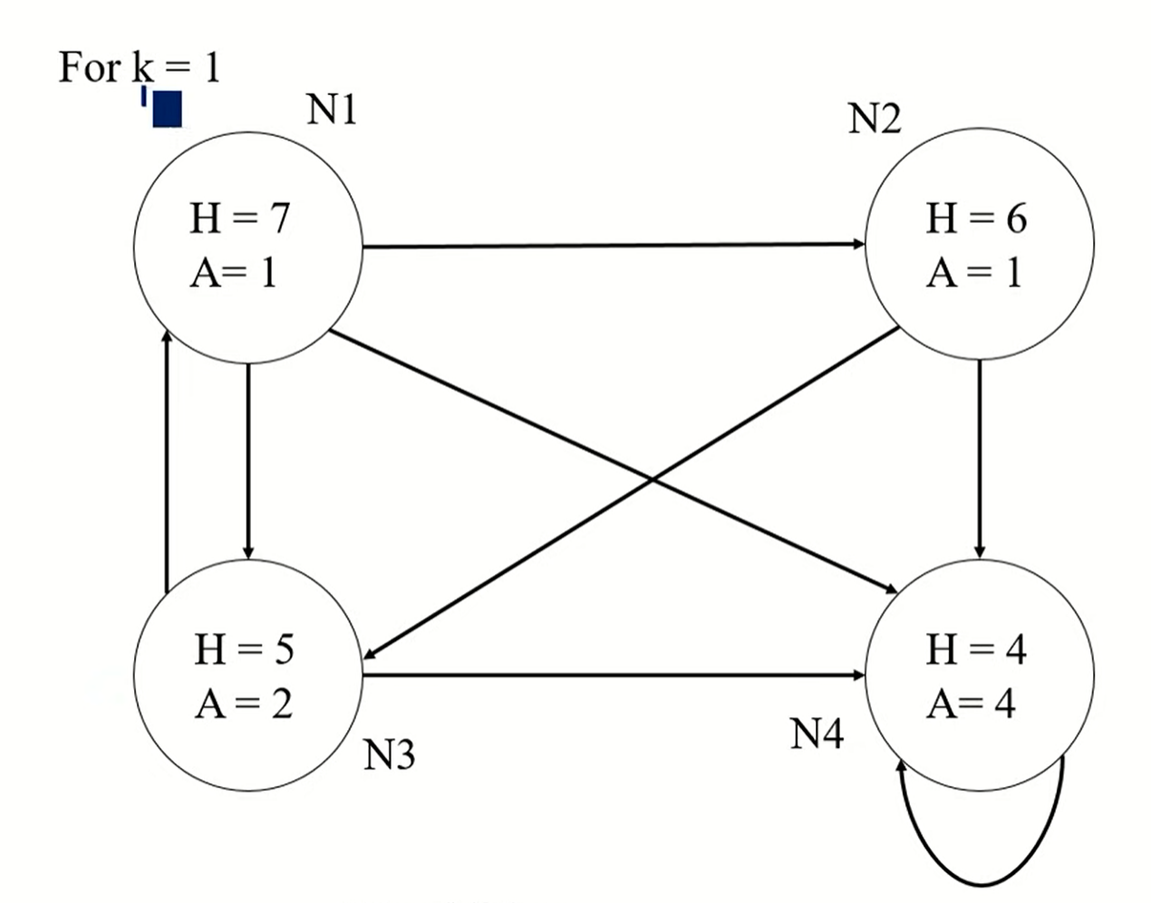
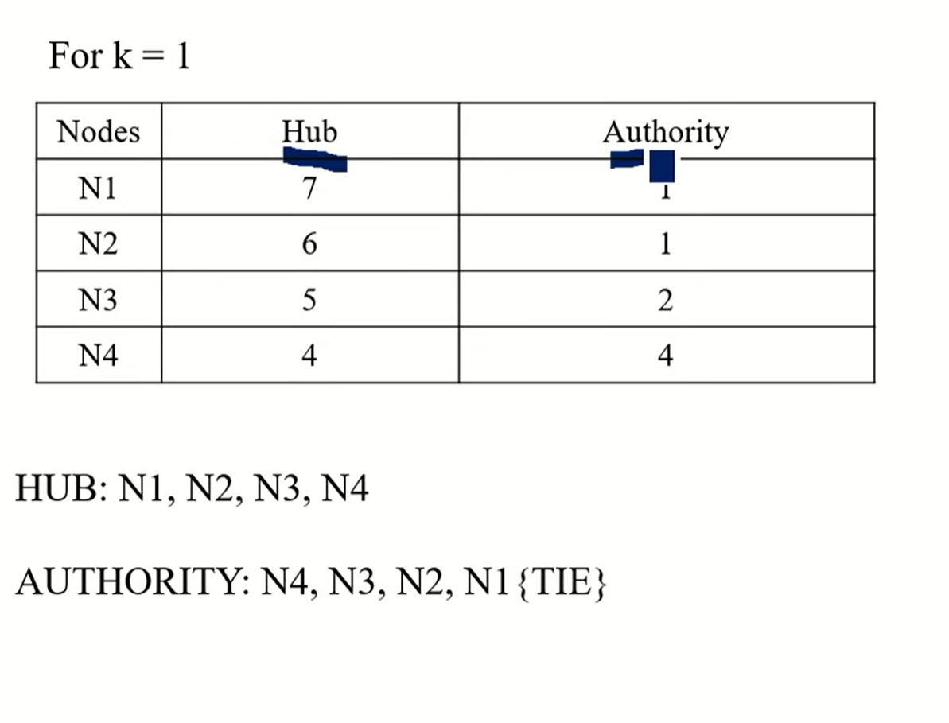
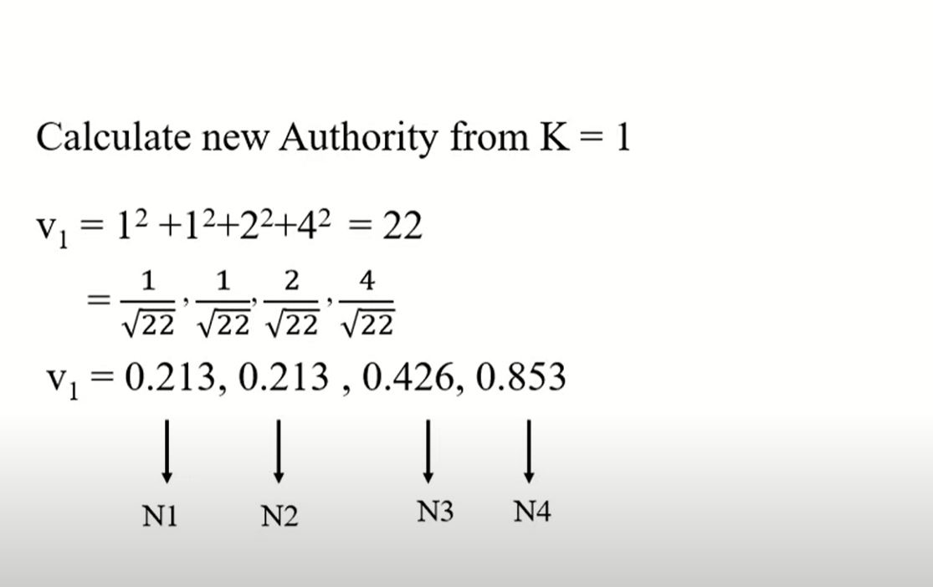
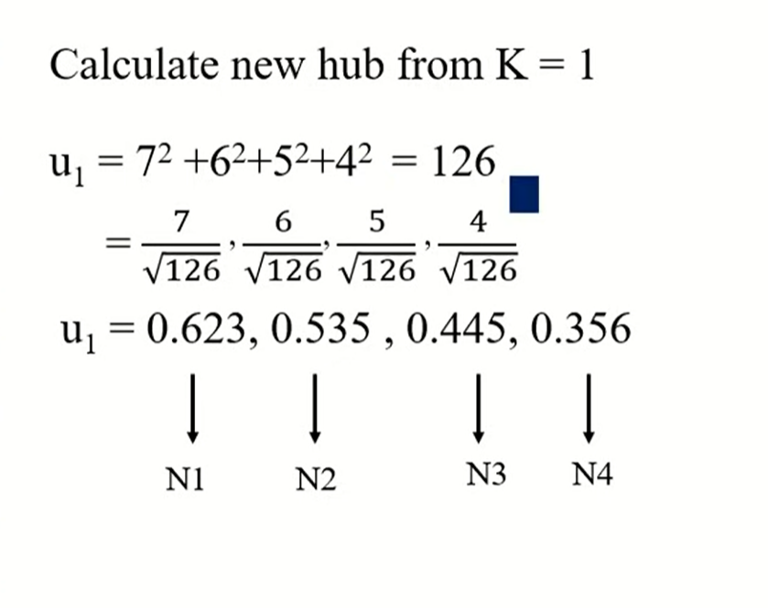

Slide 53
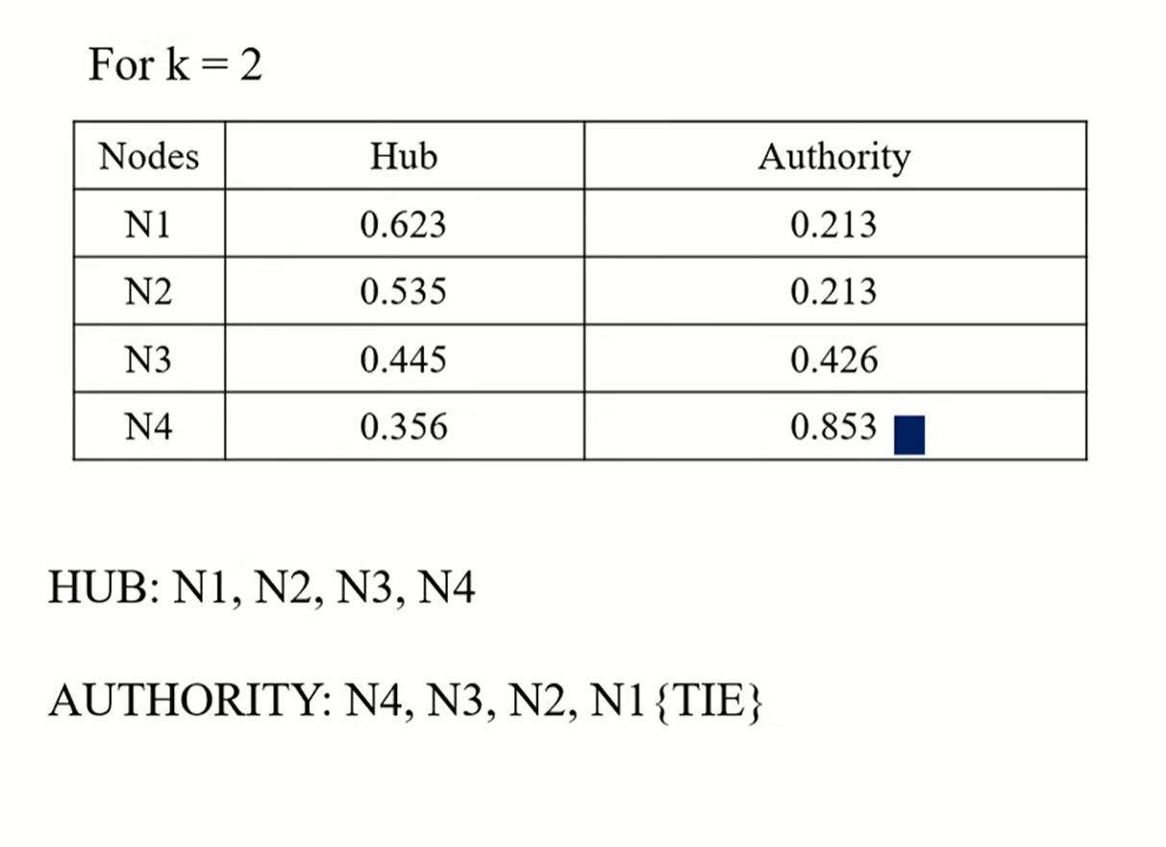
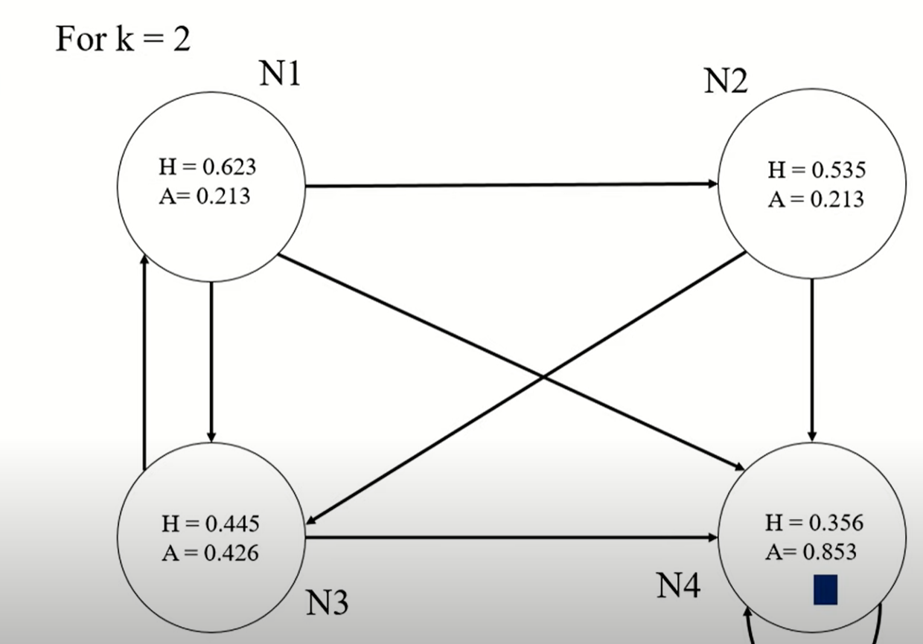
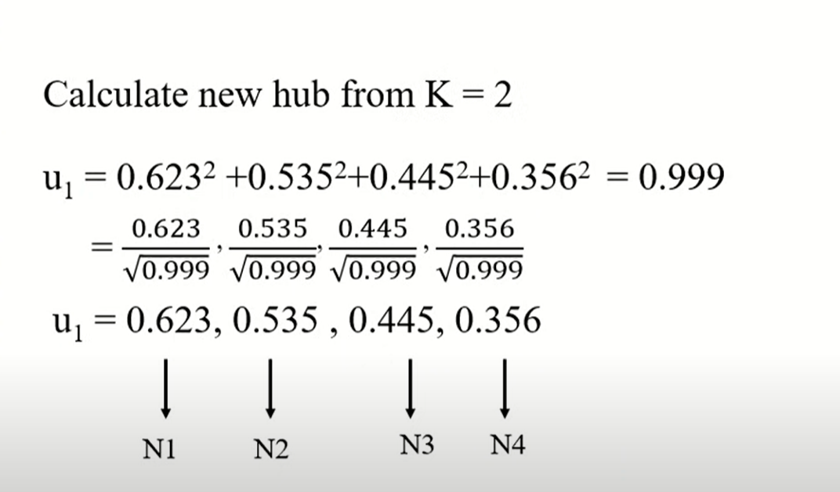
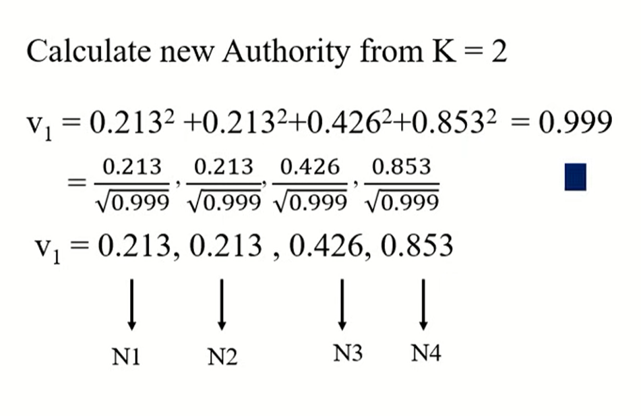

Slide 54
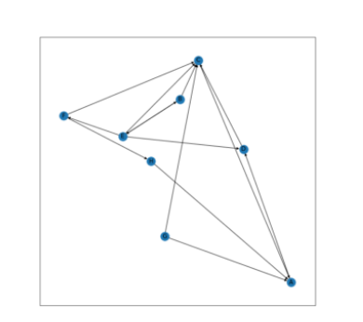
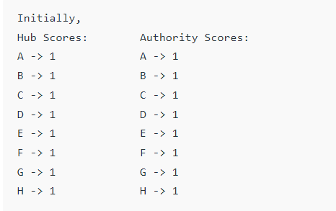

Slide 55
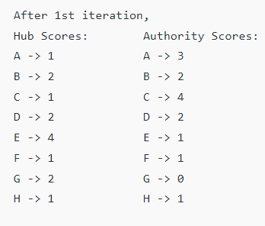
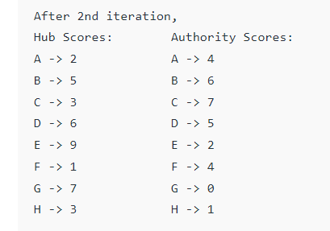
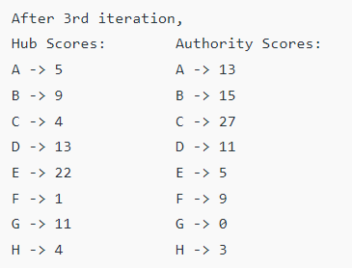

Slide 56



Slide 57
What is the difference between PageRank and HITS algorithm?
Two popular webpage ranking algorithms are HITS and PageRank. HITS emphasizes mutual reinforcement be- tween authority and hub webpages, while PageRank em- phasizes hyperlink weight normalization and web surfing based on random walk models.

Slide 58
Focused and Regular Crawling
A focused web crawler is a hypertext system that investigates, acquires, indexes, and supports pages on a definite set of subjects that define a relatively narrow segment of the web. It requires a very small investment in the hardware and web resources and yet manages respectable coverage at a quick rate, simply because there is relatively small to do.
The focused web crawler is conducted by a classifier that learns to identify relevance from examples embedded in a topic taxonomy, and a distiller which recognizes topical vantage points on the internet.
Focused web crawlers use vertical search engines to crawl web pages specific to a target topic. Each fetched page is classified into predefined target topic(s). If the page is predicted to be on-topic, then its links are extracted and are appended into the URL queue.
A focused crawler is a web crawler that collects Web pages that satisfy some specific property, by carefully prioritizing the crawl frontier and managing the hyperlink exploration process.^{[1]} Some predicates may be based on simple, deterministic and surface properties. For example, a crawler's mission may be to crawl pages from only the .jp domain. Other predicates may be softer or comparative, e.g., "crawl pages about baseball", or "crawl pages with large PageRank".

Slide 59
Regular Crawling
Web crawling is the process of indexing data on web pages by using a program or automated script. These automated scripts or programs are known by multiple names, including web crawler, spider, spider bot, and often shortened to crawler.
Website Crawling is the automated fetching of web pages by a software process, the purpose of which is to index the content of websites so they can be searched. The crawler analyzes the content of a page looking for links to the next pages to fetch and index.

Slide 60
Data Structures and Pattern Analysis

Slide 61


Slide 62


Slide 63


Slide 64

a suffix tree (also called PAT tree or, in an earlier form, position tree) is a compressed trie containing all the suffixes of the given text as their keys and positions in the text as their values.

Slide 65


Slide 66
Pattern Discovery
Statistical Analysis
Classification
Clustering
Association Rule Mining
Sequential Patterns

Slide 67







Slide 68

Pattern Analysis

Slide 69


Slide 71
Text Mining

Slide 72
Most previous studies of data mining have focused on structured data, such as relational, transactional, and data warehouse data.
However, in reality, a substantial portion of the available information is stored in text databases (or document databases), which consist of large collections of documents from various sources, such as news articles, research papers, books, digital libraries, e-mail messages, and Web pages.
Text databases are rapidly growing due to the increasing amount of information available in electronic form, such as electronic publications, various kinds of electronic documents, e-mail, and the WorldWideWeb (which can also be viewed as a huge, interconnected, dynamic text database).

Slide 73
Nowadays most of the information in government, industry, business, and other institutions are stored electronically, in the form of text databases.
Data stored in most text databases are semistructured data in that they are neither completely unstructured nor completely structured.
For example, a document may contain a few structured fields, such as title, authors, publication date, category, and so on, but also contain some largely unstructured text components, such as abstract and contents.
There have been a great deal of studies on the modeling and implementation of semistructured data in recent database research.
Moreover, information retrieval techniques, such as text indexing methods, have been developed to handle unstructured documents.

Slide 74
Traditional information retrieval techniques become inadequate for the increasingly vast amounts of text data.
Typically, only a small fraction of the many available documents will be relevant to a given individual user.
Without knowing what could be in the documents, it is difficult to formulate effective queries for analyzing and extracting useful information from the data.
Users need tools to compare different documents, rank the importance and relevance of the documents, or find patterns and trends across multiple documents.
Thus, text mining has become an increasingly popular and essential theme in data mining.

Slide 75
Text analysis (TA) is a machine learning technique used to automatically extract valuable insights from unstructured text data. Companies use text analysis tools to quickly digest online data and documents, and transform them into actionable insights.
Text analysis delivers qualitative results and text analytics delivers quantitative results.
If a machine performs text analysis, it identifies important information within the text itself, but if it performs text analytics, it reveals patterns across thousands of texts, resulting in graphs, reports, tables etc.
Text Analysis Is Scalable
Text analysis tools allow businesses to structure vast quantities of information, like emails, chats, social media, support tickets, documents, and so on, in seconds rather than days, so you can redirect extra resources to more important business tasks.
Analyze Text in Real-time

Slide 76


Slide 77
Text classification is the process of assigning predefined tags or categories to unstructured text. It's considered one of the most useful natural language processing techniques because it's so versatile and can organize, structure, and categorize pretty much any form of text to deliver meaningful data and solve problems. Natural language processing (NLP) is a machine learning technique that allows computers to break down and understand text much as a human would.
Sentiment Analysis
Customers freely leave their opinions about businesses and products in customer service interactions, on surveys, and all over the internet. Sentiment analysis uses powerful machine learning algorithms to automatically read and classify for opinion polarity (positive, negative, neutral) and beyond, into the feelings and emotions of the writer, even context and sarcasm.

Slide 78
Text mining is a component of data mining that deals specifically with unstructured text data. It involves the use of natural language processing (NLP) techniques to extract useful information and insights from large amounts of unstructured text data. Text mining can be used as a preprocessing step for data mining or as a standalone process for specific tasks.
“Extraction of interesting information or patterns from data in large databases is known as data mining.”

Slide 79




Slide 80
“What is information retrieval?”
Information retrieval (IR) is a field that has been developing in parallel with database systems for many years.
Information retrieval is concerned with the organization and retrieval of information from a large number of text-based documents.
Since information retrieval and database systems each handle different kinds of data, some database system problems are usually not present in information retrieval systems, such as concurrency control, recovery, transaction management, and update.
Also, some common information retrieval problems are usually not encountered in traditional database systems, such as unstructured documents, approximate search based on keywords, and the notion of relevance.

Slide 81
Let the set of documents relevant to a query be denoted as {Relevant}
The set of documents retrieved be denoted as {Retrieved}.
The set of documents that are both relevant and retrieved is denoted as {Relevant} U {Retrieved}
Precision, recall, and F-score are the basic measures of a retrieved set of documents.

Slide 82


Slide 83

Application
Digital Library
Academic and research field
Life science
Social Media
Business Intelligence

Slide 84


Slide 85


